Slide 1
The Hitchhikers Guide to the Home Network: Analyzing IoT Traffic
Maria Melchiorre, Alicia Ouyang, Christopher Morris, Kim Gavin,

Slide 2



Introductions
Maria Melchiorre
Alicia Ouyang
Christopher Morris

Slide 3



Introductions
Amy Schmid
Recruitment
Lizzy Barr
Recruitment
Kim Gavin
Emerging Technologies

Slide 4
Game Plan
Background in IoT
Hardware Setup
Network Traffic Setup
MitM Attack
Data Visualization

Slide 5
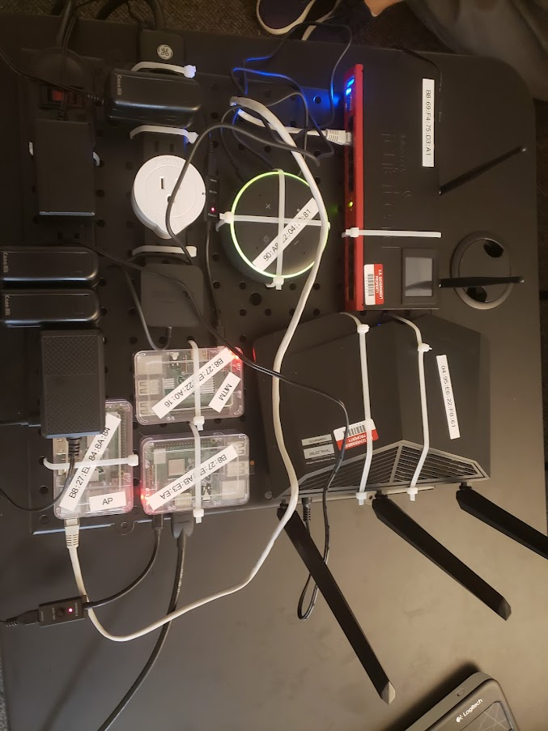





Our Lab Setup
Hardware
Software
Raspberry Pi 3s
Routers (MikroTik RB2011 and Tenda AC18)
Common IoT Devices (Alexa, Etekcity Smart Outlet)

Slide 6
GitHub Link
https://tinyurl.com/str-wicys

Slide 7

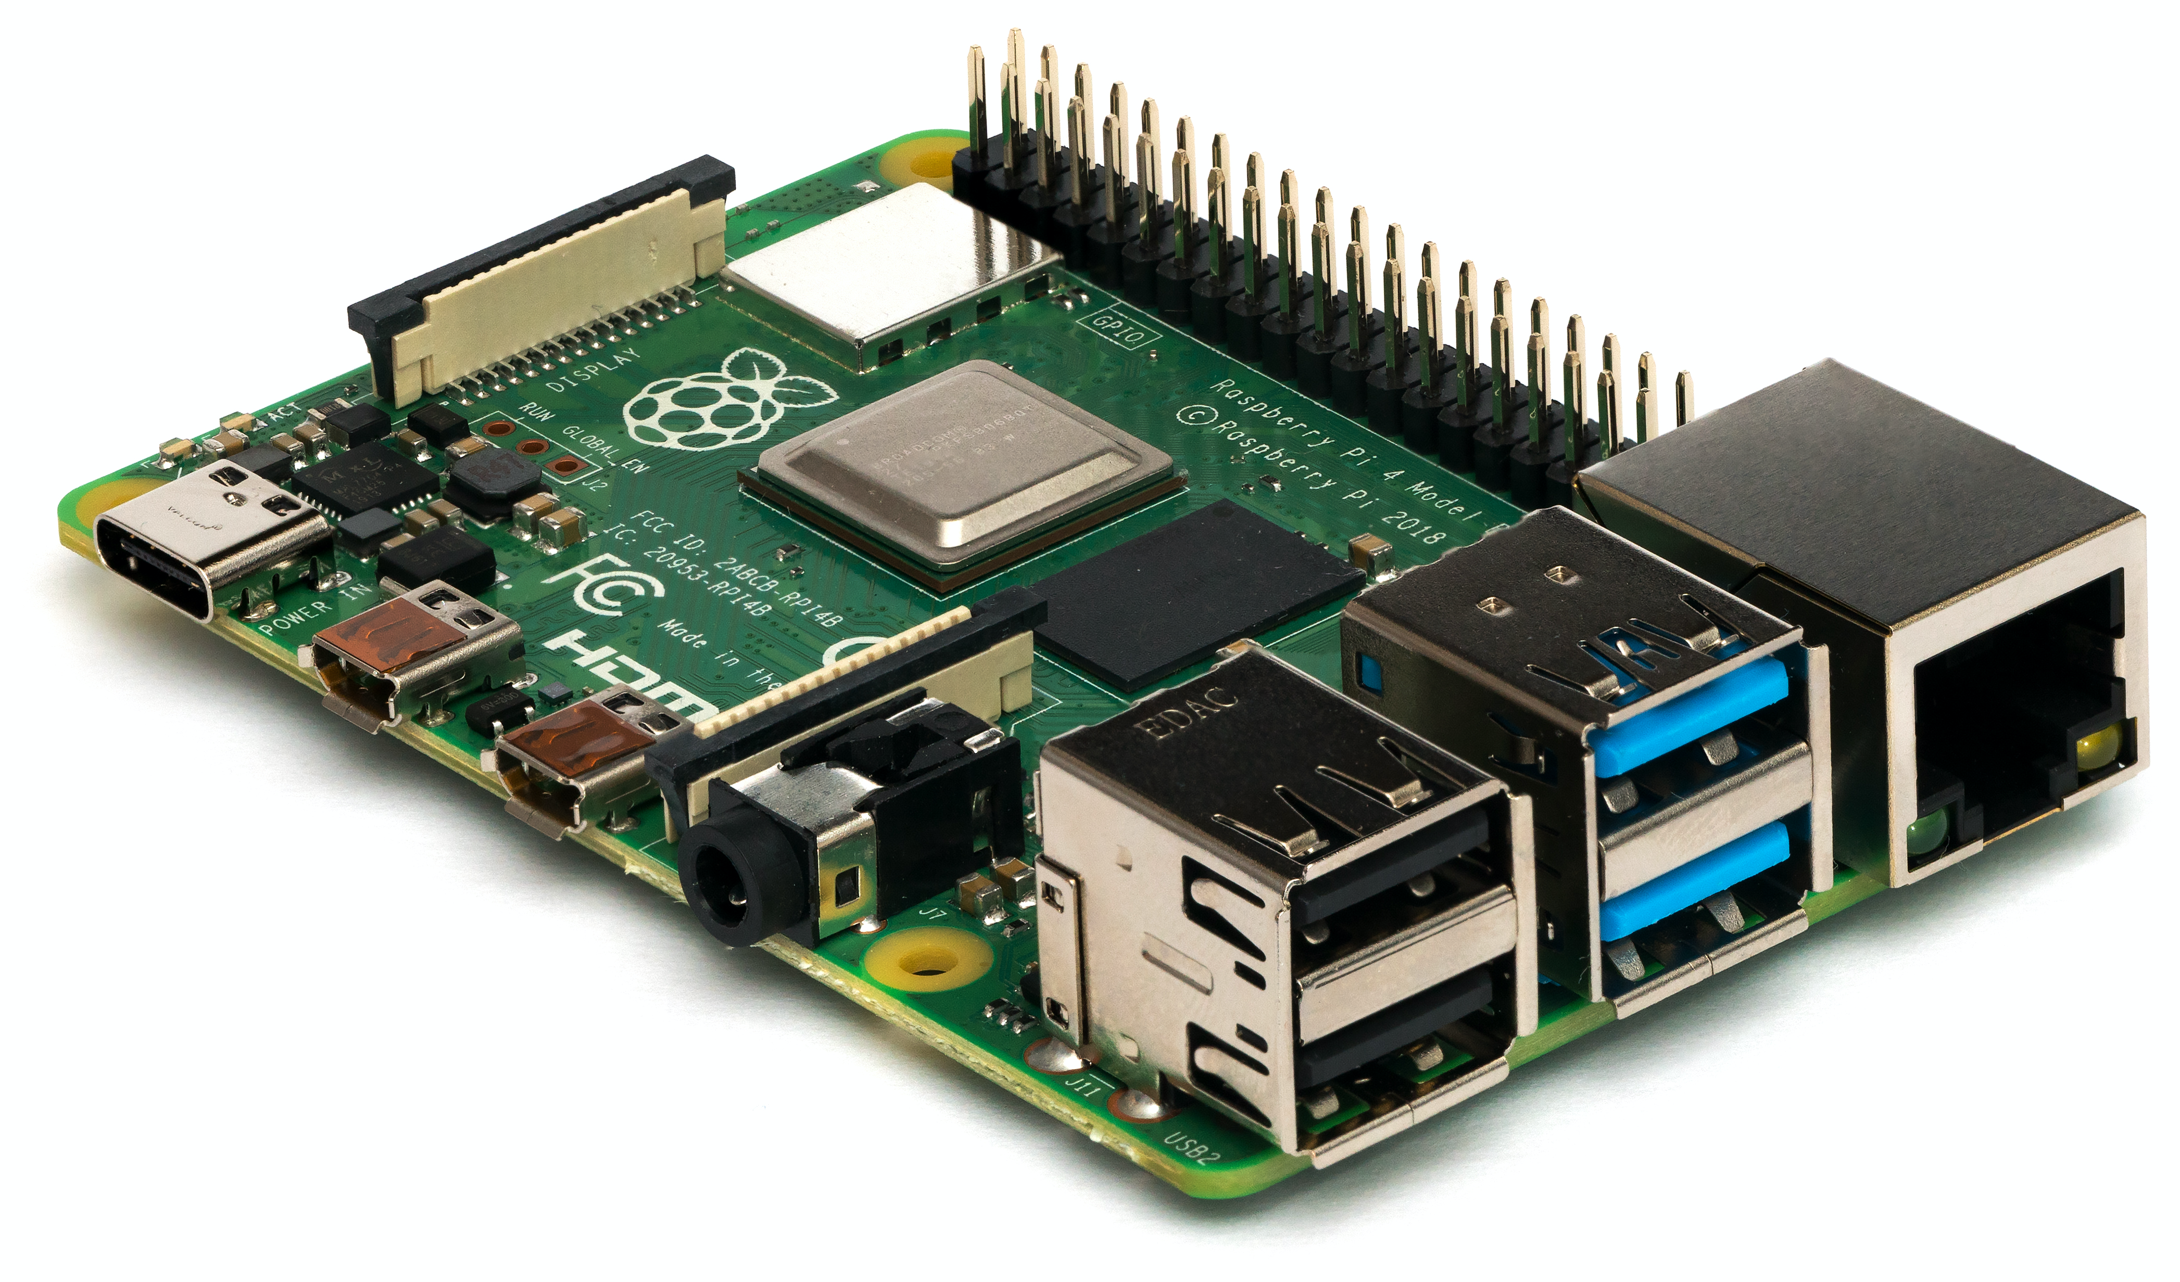

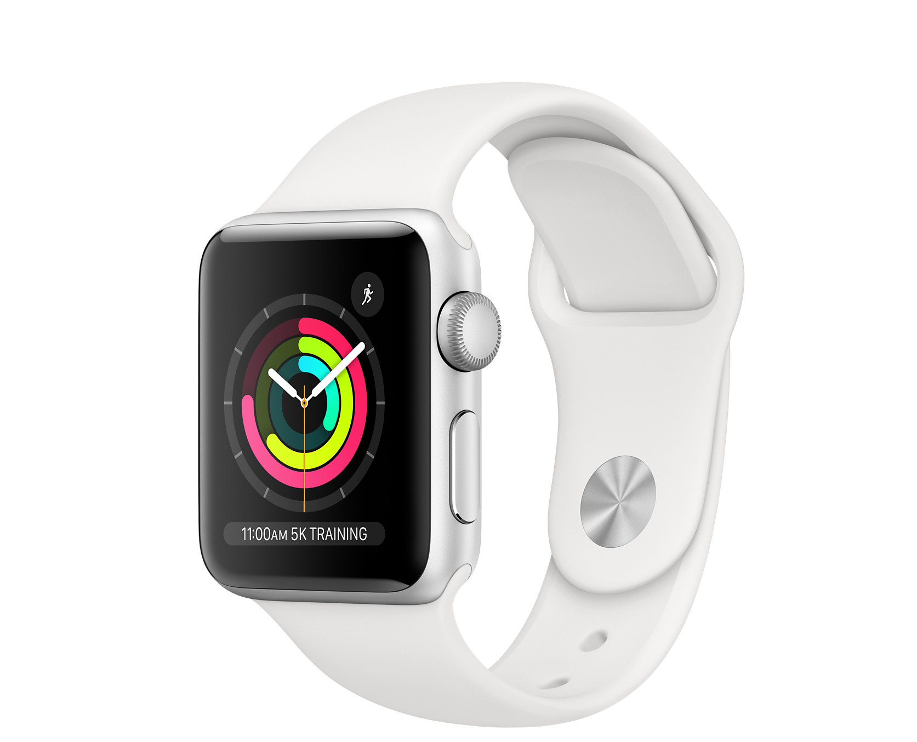

What’s IoT?
IoT refers to all the physical devices in the world that are connected to the internet, and they are collecting and sharing data.

Slide 8
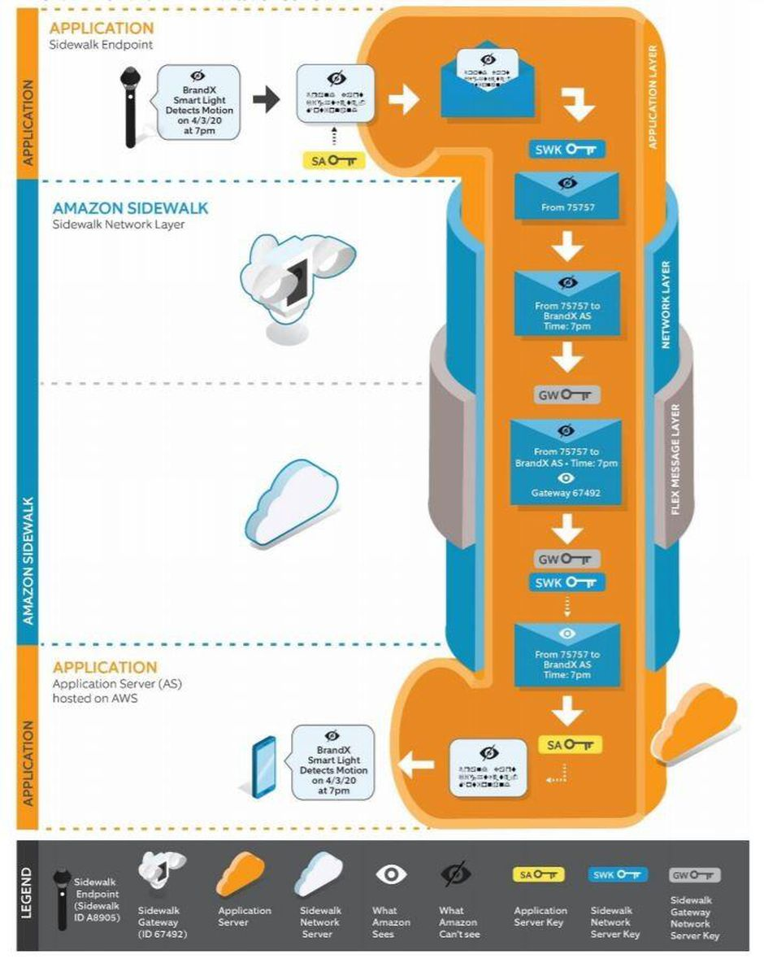
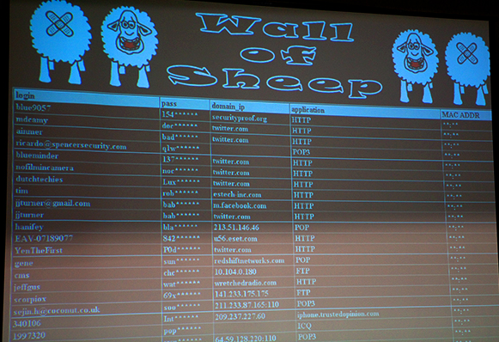
IoT and Security
Do you know who can see your traffic? Can they see the data you’re outputting?
Src: Wall of Sheep
Amazon Sidewalk White Paper
Notes:
https://m.media-amazon.com/images/G/01/sidewalk/final_privacy_security_whitepaper.pdf

Slide 9





Signal Processing in IoT
Image Processing
Facebook tagging technology
Replacing human workers in conveyor belt applications
Smart agriculture
Audio Processing
Monitoring machinery for defects
Healthcare

Slide 10
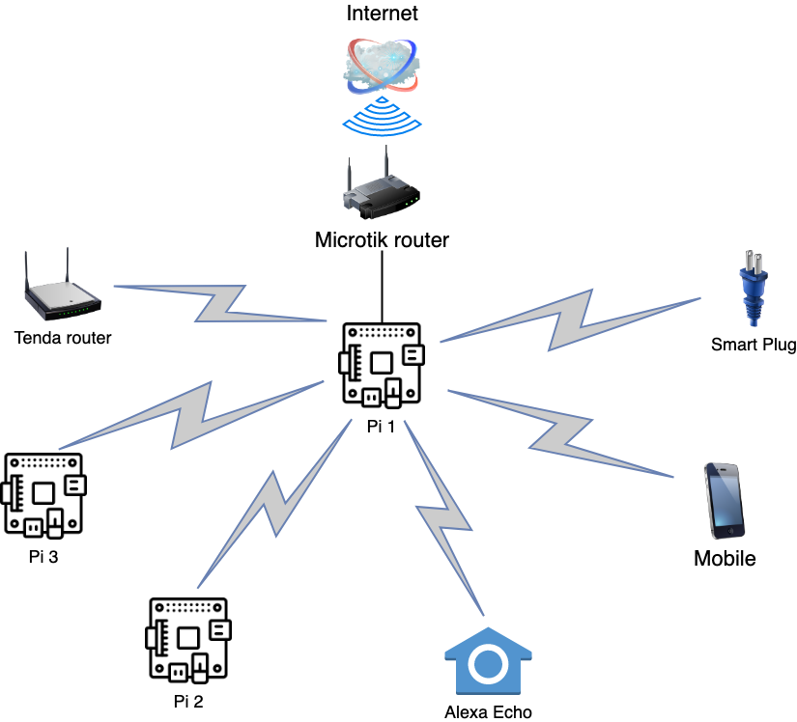
Network Setup
Created a hardware lab consisting of three Raspberry Pi 3s, two routers, several "smart" devices, and a power supply.
We chose devices that connect to the Internet so we can observe their network traffic (and exploit a known vulnerability!).
The MikroTik router provides internet connectivity to all gadgets, who communicate with each other over the network.
One of the Raspberry Pis is acting as a wireless bridge for the Mikrotik Router, another is acting as the attacker.

Slide 11
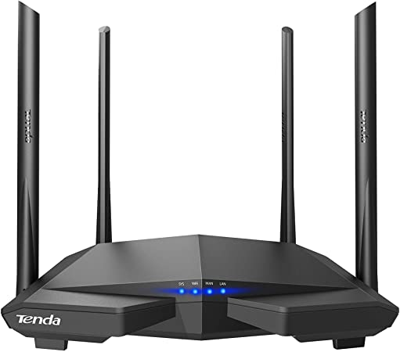
Vulnerability Example

Slide 12
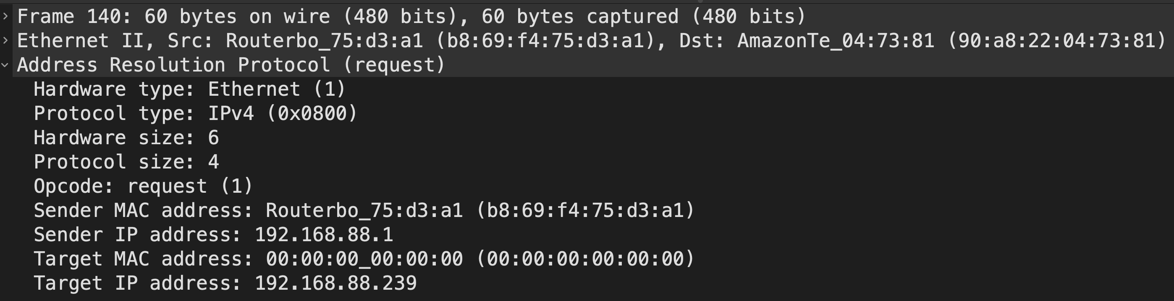
Address Resolution Protocol Request

Slide 13
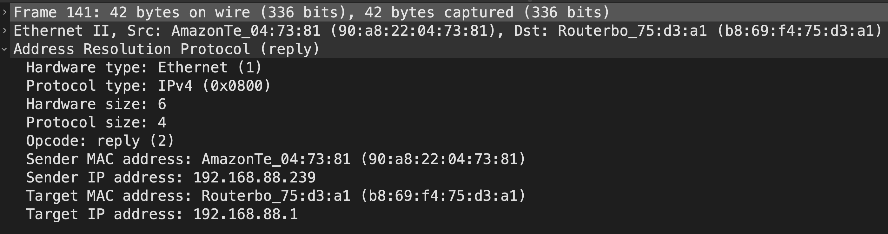
ARP Reply

Slide 14
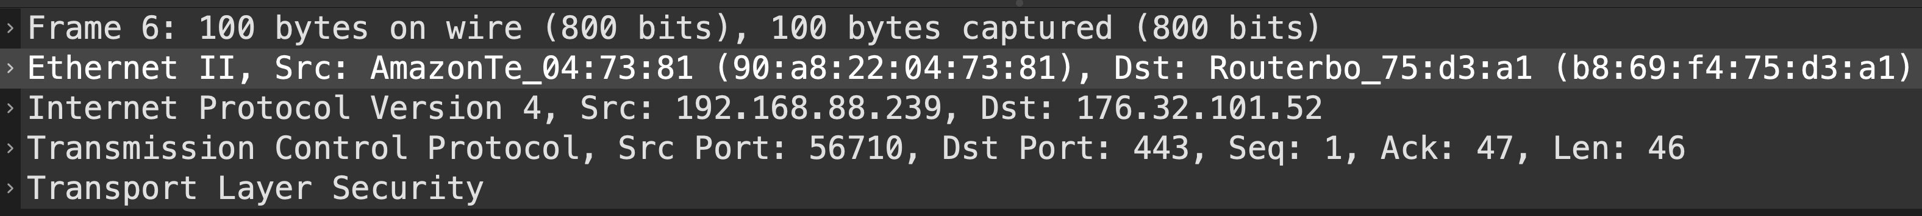
OSI Model
OSI Stack
Application
Presentation
Session
Transport
Network
Data Link
Physical

Slide 15
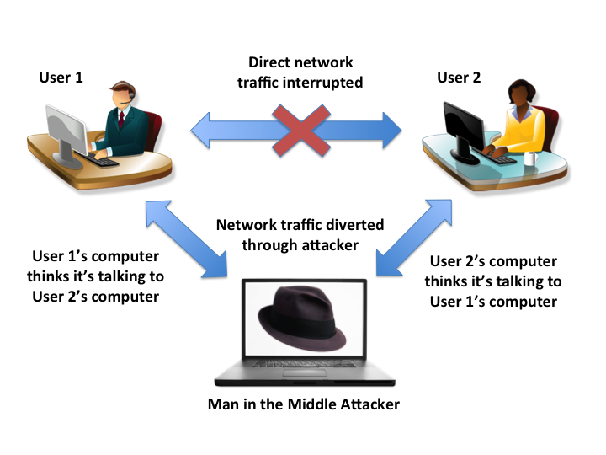
MitM in Daily Life
UCLA Introduction to Security Course

Slide 16
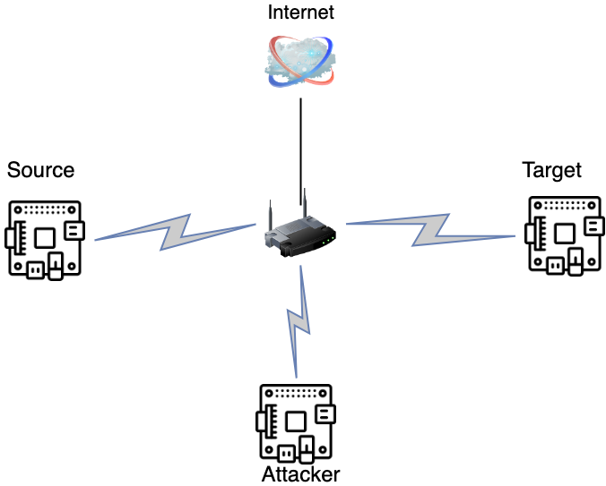
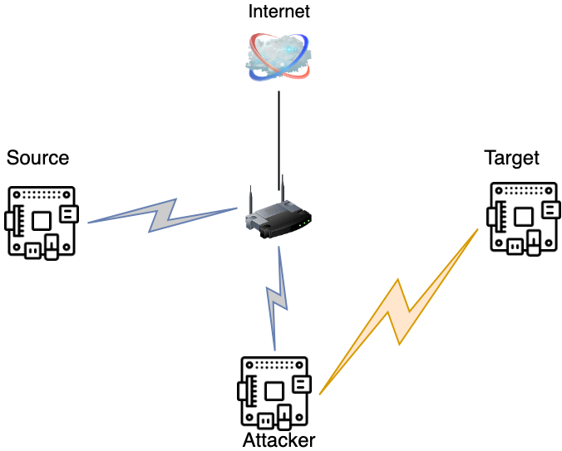
MitM Attack
A malicious entity intercepts a connection between the user and a legitimate source of communication.
By appearing to be inconspicuous (such as a public Wi-Fi network), the attacker can manipulate the user into submitting private information.
Network traffic is then forwarded to the attacker, which allows them to view, modify, and reroute the information.

Slide 17
ARP Spoofing!
Address Resolution Protocol was not built with security in mind.
Any device can claim to be any other device!
Hello! I’m the Amazon Alexa!

Slide 18
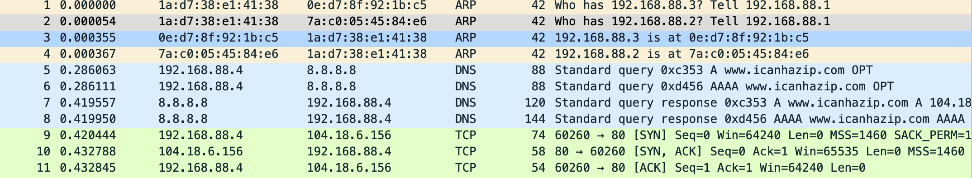
Okay, Now What?
We can collect network traffic, and we can display it in “plain text”:
Can you determine within seconds, which devices are talking to each other?
What is the rate of traffic?

Slide 19
Process for Data Analysis
What are the questions you are trying to answer?
Ex: Is there unexpected traffic in my network?
Do you have the data available to answer the question?
Dataset may require cleaning/restructuring due to holes
What is the best way to represent that answer?
What kind of data are you working with?
Dynamic versus Static Charts
Smart use of colors/texture
Repeat and iterate!

Slide 20
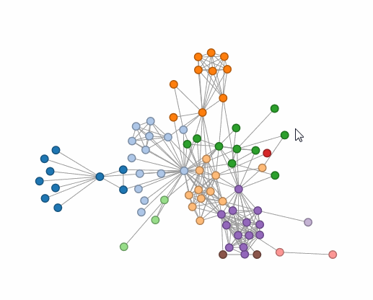



Other Uses for Data
Using Machine Learning algorithms to detect abnormal traffic (levels, connections, etc.)
Decision Trees
Reinforcement Learning
Set up thresholds for algorithms to change network behavior
Conducting statistic analysis to prove statistical significance
Ex: trying to reject the null hypothesis that normal traffic and traffic during a DDoS MITM attack are the same
More sophisticated data visualizations!
Highlight selected node example

Slide 21

Recap
Encrypt and secure your devices/networks whenever possible!
Check for vulnerabilities in devices.
Raspberry Pis are underrated for prototyping.
The power of data is through the right questions.
Stay curious, the different tools we’ve used today are super useful.
Be careful connecting to public Wi-Fi networks, especially if no password is required!

Slide 22

Get In Contact
TECHNICAL:
ALICIA.OUYANG@STR.US
MARIA.MELCHIORRE@STR.US
CHRISTOPHER.MORRIS@STR.US
RECRUITING:
AMY.SCHMID@STR.US
ELIZABETH.BARR@STR.US
STR:
KIM.GAVIN@STR.US
SOCIAL PLATFORMS

Slide 23
QUESTIONS?

